Slide 1
Distances
Determine where distance calculations are required
Calculate distances
Explain the limits on dead end corridors and common path of travel

Slide 2
Historic Fire
Iroquois Theater

Slide 3
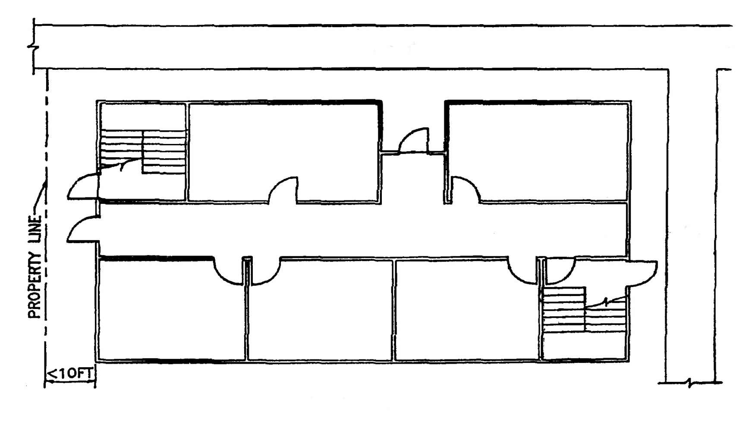
Travel Distance
When to measure
Two paths
EXIT ACCESS
STREET
EXIT DISCHARGE
S
T
R
E
E
T
EXIT
GROUND FLOOR

Slide 4


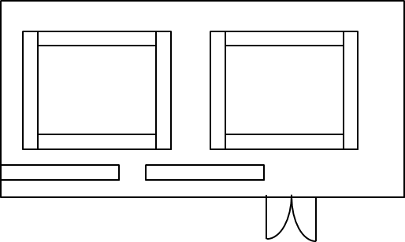
Rooms
How to measure

Slide 5
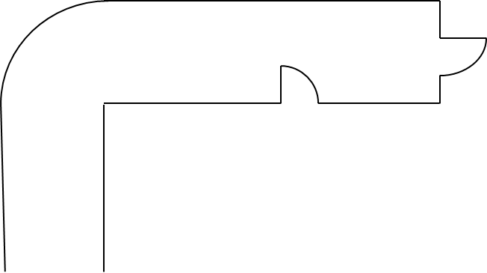
Corridors
Natural path
Minimum 12 in clearance around curves/obstructions
To exit
  Door

Slide 6
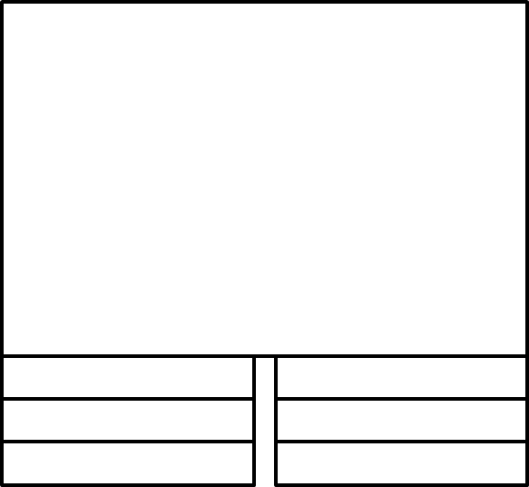
Stairs
On treads
On landing

Slide 7
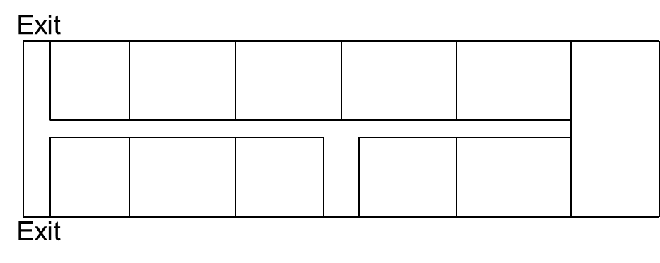
Areas of Concern
Dead End Corridors
Common Path of Travel

